Slide 1
Progress Report
2025-11-18

Slide 2
Contents
Confirm the seasonality behavior of demand in several failure models.
Integrate demand simulator, forecasting model and cost simulator.
Evaluate forecasting model via the integrated simulator.
Notes:
First, I define the location of each dealer. Next, I introduce a new function that reproduces seasonal demand patterns. Finally, I predict the simulated demand using the XGBoost model.

Slide 3
Intermittency
Confirm the seasonality behavior of demand in several failure models.
Integrate demand simulator, forecasting model and cost simulator.
Evaluate forecasting model via the integrated simulator.
Notes:
First, I define the location of each dealer. Next, I introduce a new function that reproduces seasonal demand patterns. Finally, I predict the simulated demand using the XGBoost model.

Slide 4
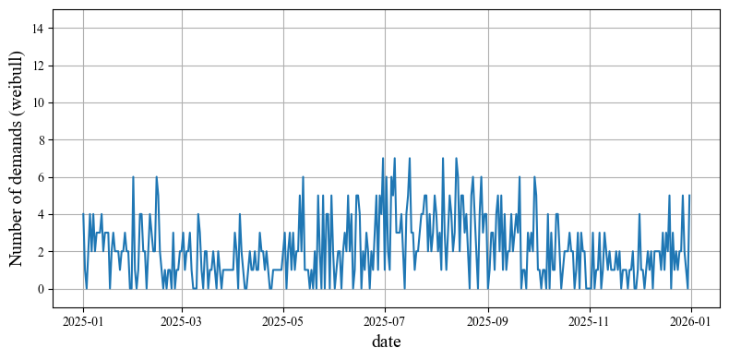
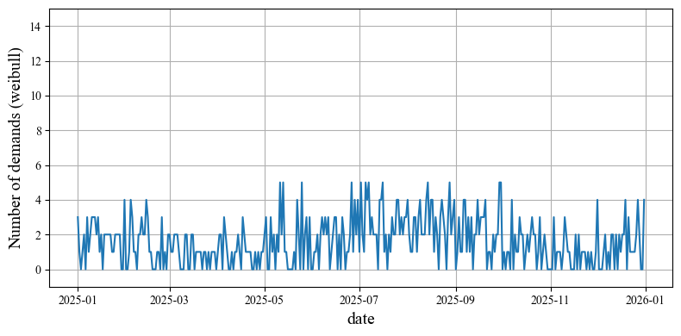
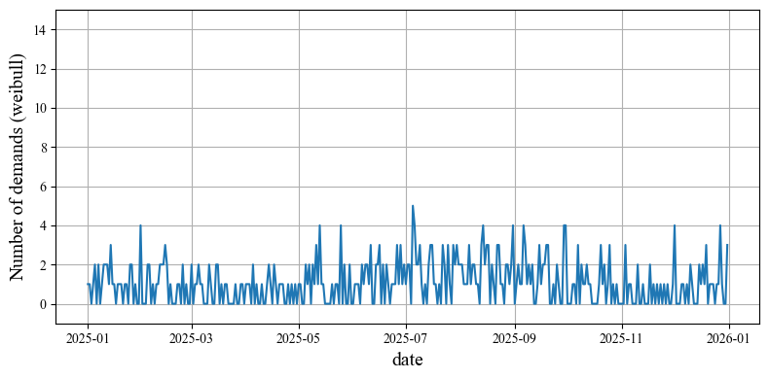
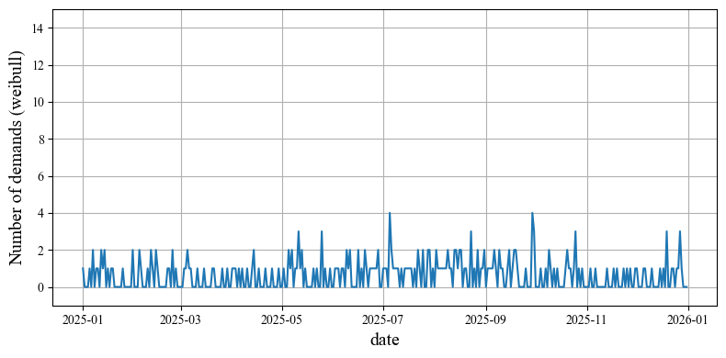
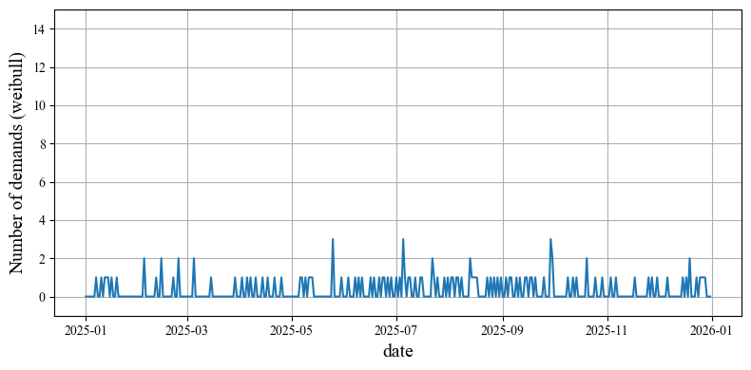
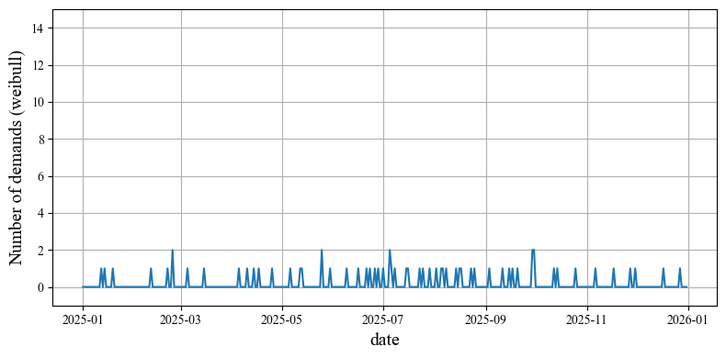
Number of trucks (Weibull, both-season part)
50 (current)
40
30
ADI=1.19, CoV=0.79, Rate=0.16
ADI=1.33, CoV=0.84, Rate=0.24
ADI=1.57, CoV=1.01, Rate=0.36
20
10
5
ADI=2.03, CoV=1.21, Rate=0.51
ADI=3.48, CoV=1.72, Rate=0.71
ADI=6.29, CoV=2.39, Rate=0.84
Notes:
By using this coefficients, we can model various types of seasonal patterns, for example, both-season, summer-only, winter-only, and no-season patterns.
Then, I simulated one year of demand
using these seasonality model for the two locations
and several types of failure models.
Specifically, I used
Weibull model, Exponential model, log-logistic model and gompertz model.

Slide 5
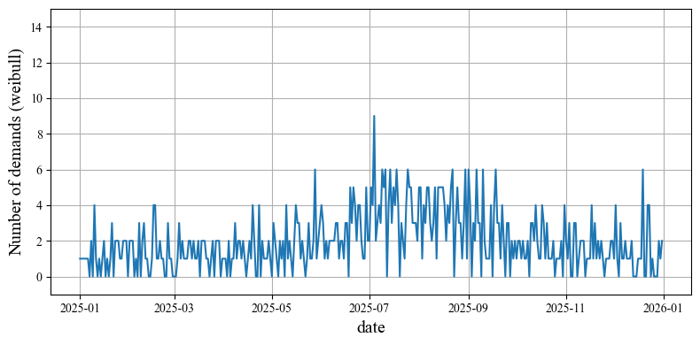
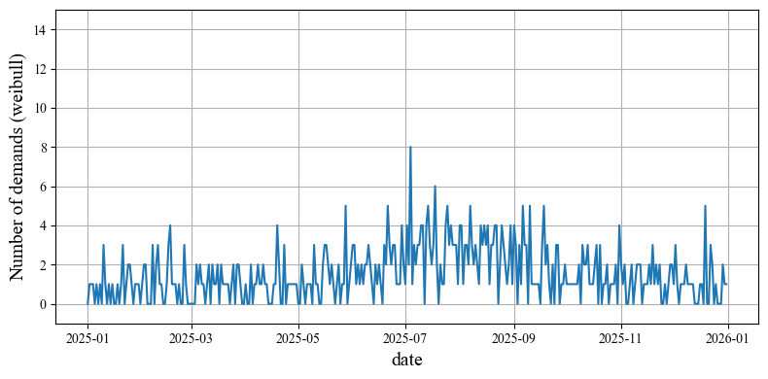
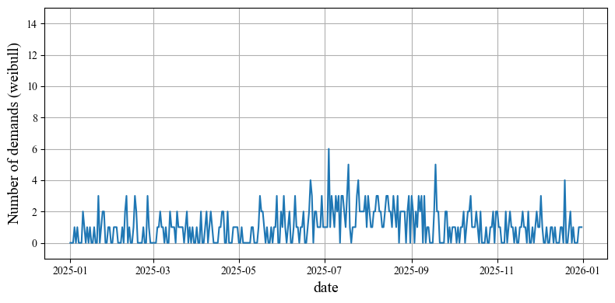
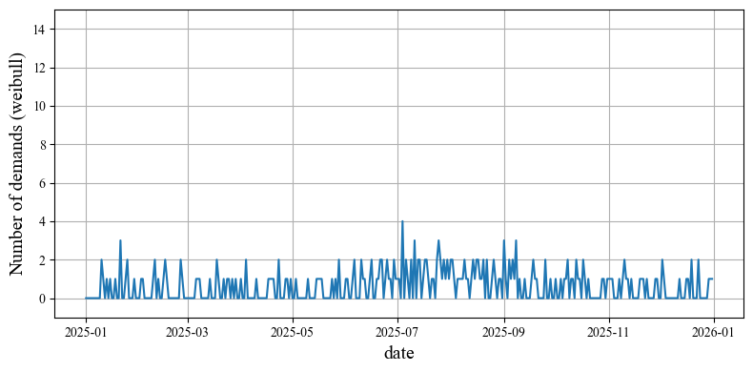
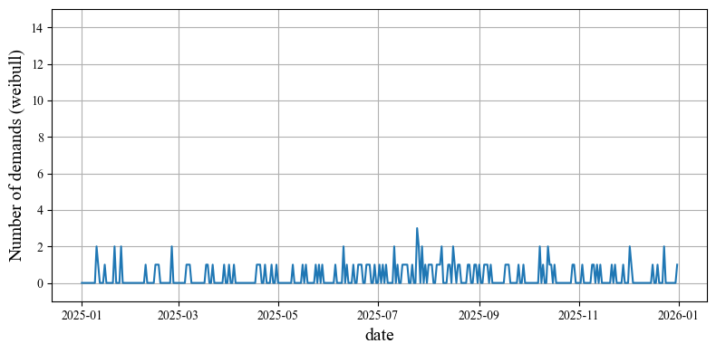
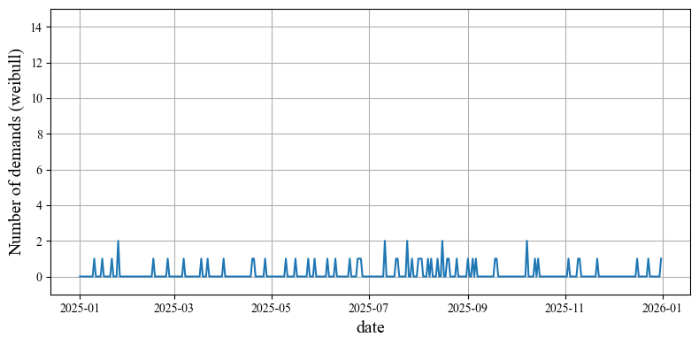
Number of trucks (Weibull, summer part)
50 (current)
40
30
ADI=1.20, CoV=0.81, Rate=0.16
ADI=1.30, CoV=0.88, Rate=0.23
ADI=1.59, CoV=1.01, Rate=0.37
20
10
5
ADI=2.12, CoV=1.23, Rate=0.53
ADI=3.47, CoV=1.69, Rate=0.71
ADI=6.88, CoV=2.53, Rate=0.85
Notes:
By using this coefficients, we can model various types of seasonal patterns, for example, both-season, summer-only, winter-only, and no-season patterns.
Then, I simulated one year of demand
using these seasonality model for the two locations
and several types of failure models.
Specifically, I used
Weibull model, Exponential model, log-logistic model and gompertz model.

Slide 6
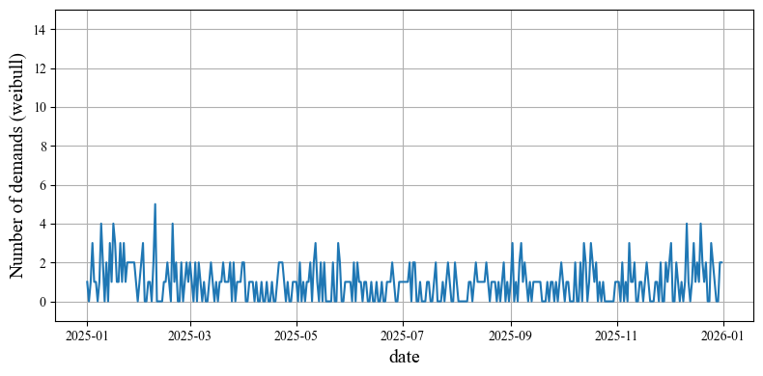
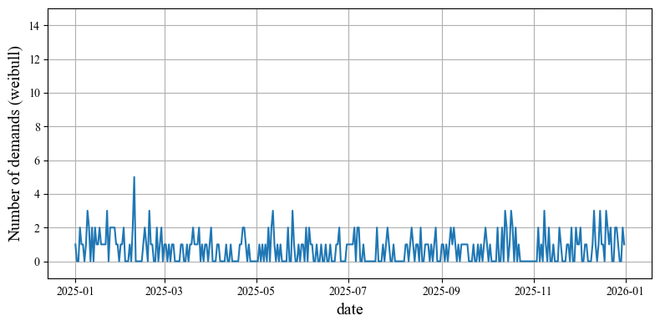
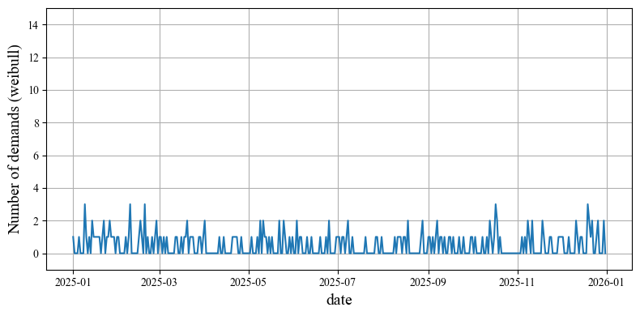
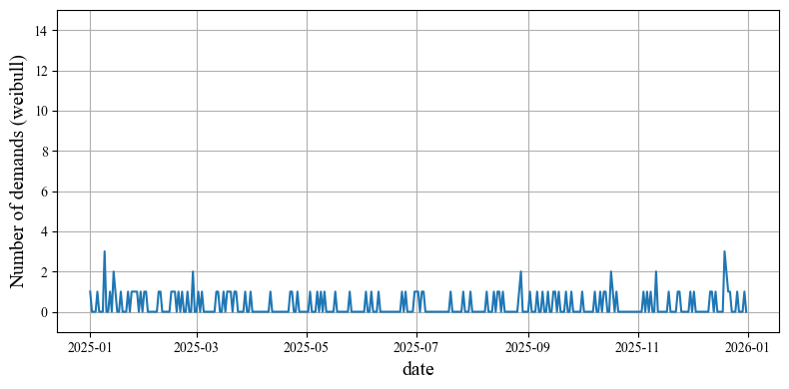
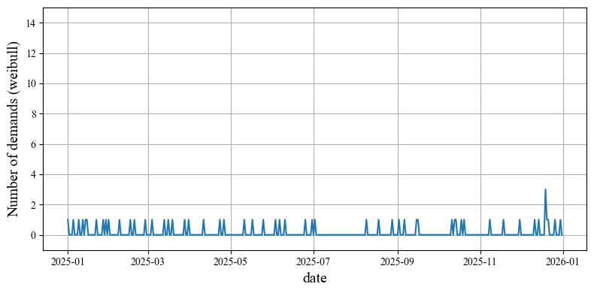
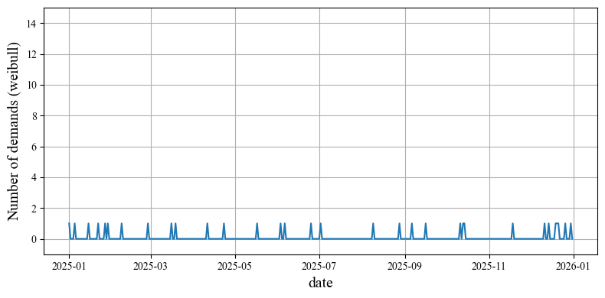
Number of trucks (Weibull, winter part)
50 (current)
40
30
ADI=1.61, CoV=1.01, Rate=0.38
ADI=1.96, CoV=1.17, Rate=0.49
ADI=2.48, CoV=1.37, Rate=0.60
20
10
5
ADI=3.61, CoV=1.73, Rate=0.72
ADI=6.76, CoV=2.50, Rate=0.85
ADI=11.40, CoV=3.23, Rate=0.91
Notes:
By using this coefficients, we can model various types of seasonal patterns, for example, both-season, summer-only, winter-only, and no-season patterns.
Then, I simulated one year of demand
using these seasonality model for the two locations
and several types of failure models.
Specifically, I used
Weibull model, Exponential model, log-logistic model and gompertz model.

Slide 7
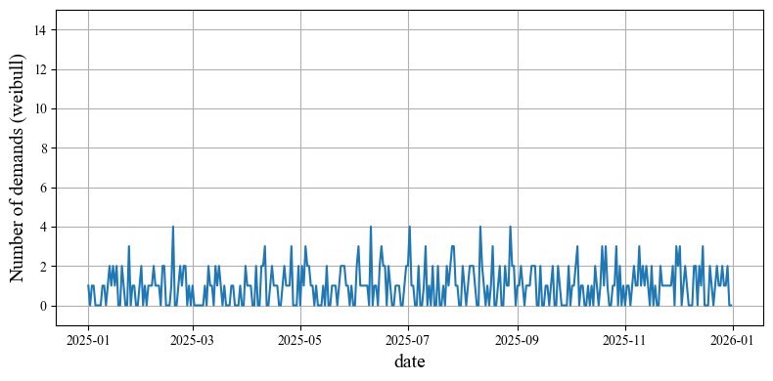
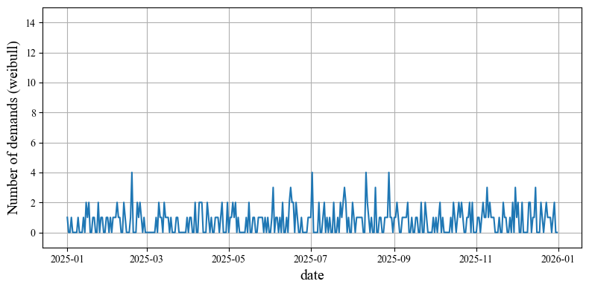
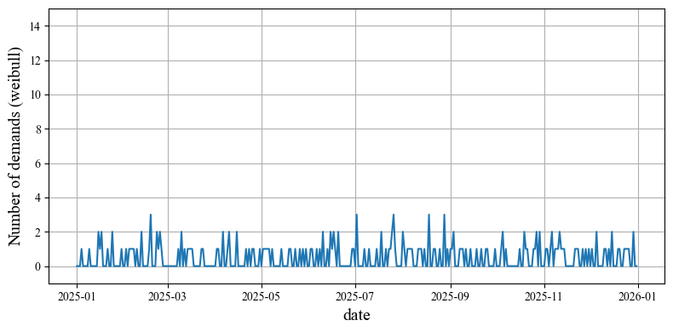
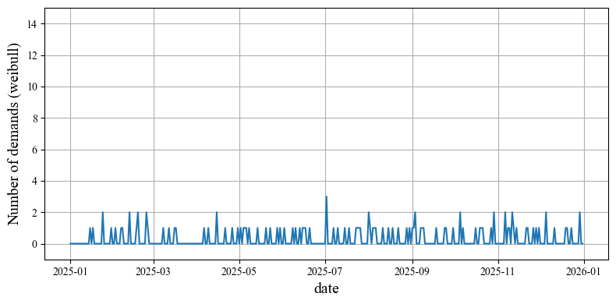
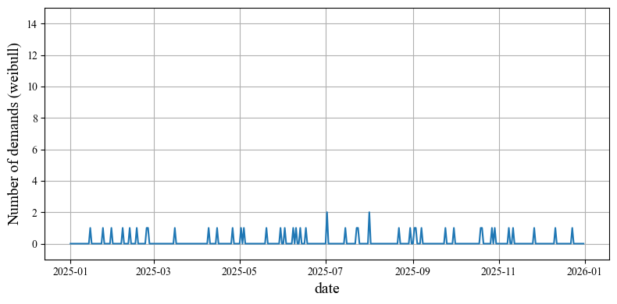
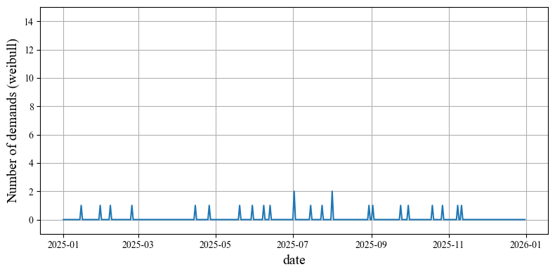
Number of trucks (Weibull, no-season part)
50 (current)
40
30
ADI=1.58, CoV=0.97, Rate=0.37
ADI=1.90, CoV=1.15, Rate=0.47
ADI=2.46, CoV=1.36, Rate=0.59
20
10
5
ADI=3.84, CoV=1.81, Rate=0.74
ADI=8.70, CoV=2.84, Rate=0.88
ADI=16.59, CoV=4.10, Rate=0.94
Notes:
By using this coefficients, we can model various types of seasonal patterns, for example, both-season, summer-only, winter-only, and no-season patterns.
Then, I simulated one year of demand
using these seasonality model for the two locations
and several types of failure models.
Specifically, I used
Weibull model, Exponential model, log-logistic model and gompertz model.

Slide 8
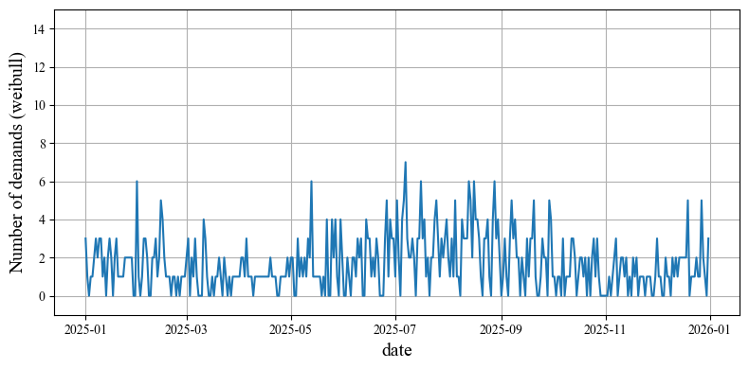
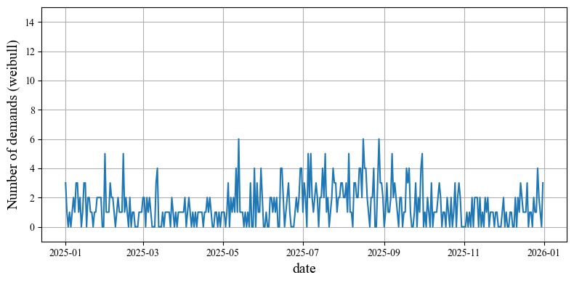
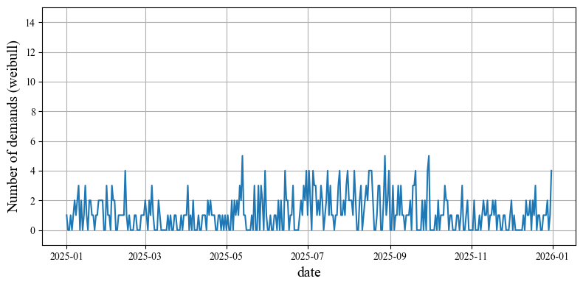
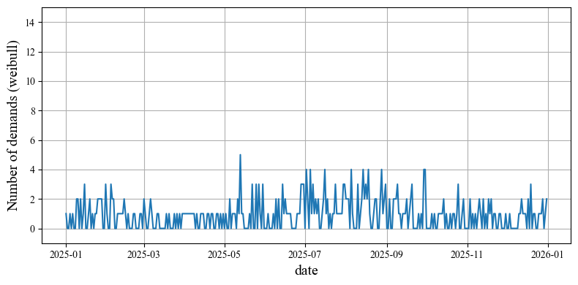
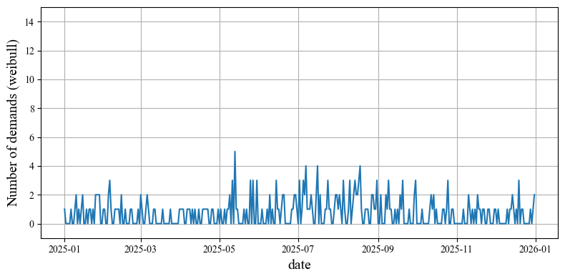
Failure Probability (Weibull, both-season part)
m=180
m=270
m=365
ADI=1.19, CoV=0.79, Rate=0.16
ADI=1.26, CoV=0.85, Rate=0.21
ADI=1.36, CoV=0.91, Rate=0.27
m=550
m=730
m=1000
ADI=1.58, CoV=1.04, Rate=0.37
ADI=1.71, CoV=1.11, Rate=0.41
ADI=2.01, CoV=1.25, Rate=0.50
Notes:
By using this coefficients, we can model various types of seasonal patterns, for example, both-season, summer-only, winter-only, and no-season patterns.
Then, I simulated one year of demand
using these seasonality model for the two locations
and several types of failure models.
Specifically, I used
Weibull model, Exponential model, log-logistic model and gompertz model.

Slide 9

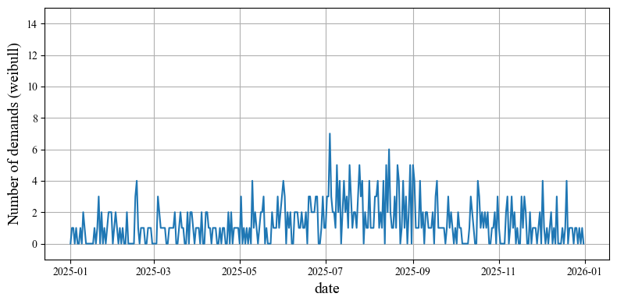
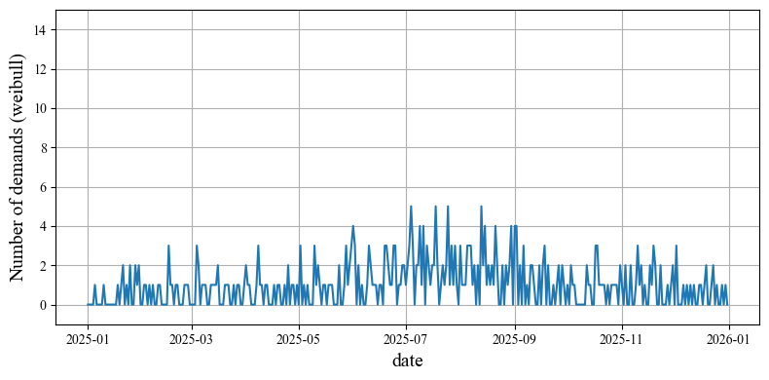
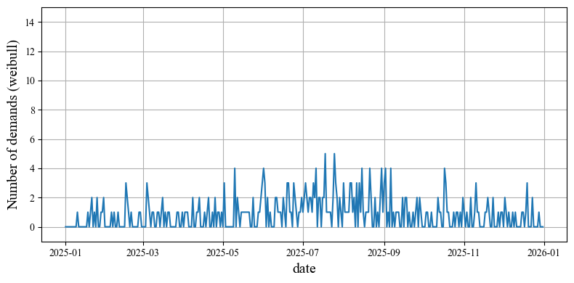
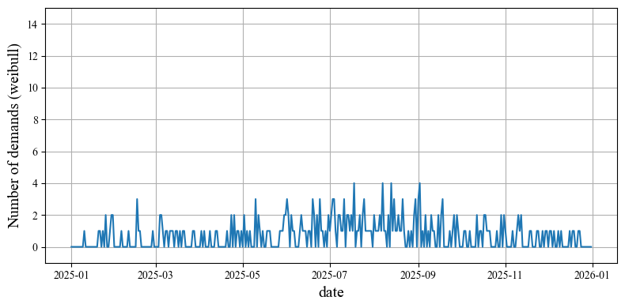
Failure Probability (Weibull, summer part)
m=180
m=270
m=365
ADI=1.20, CoV=0.81, Rate=0.16
ADI=1.31, CoV=0.85, Rate=0.21
ADI=1.45, CoV=1.00, Rate=0.31
m=550
m=730
m=1000
ADI=1.68, CoV=1.10, Rate=0.41
ADI=1.89, CoV=1.22, Rate=0.47
ADI=2.05, CoV=1.25, Rate=0.51
Notes:
By using this coefficients, we can model various types of seasonal patterns, for example, both-season, summer-only, winter-only, and no-season patterns.
Then, I simulated one year of demand
using these seasonality model for the two locations
and several types of failure models.
Specifically, I used
Weibull model, Exponential model, log-logistic model and gompertz model.

Slide 10
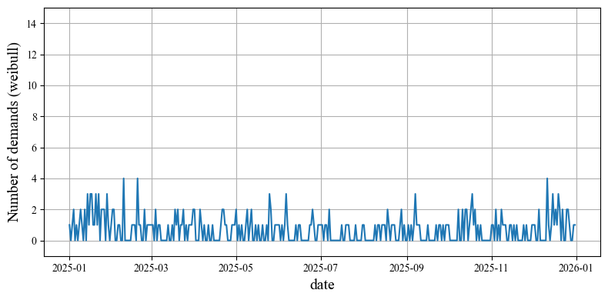
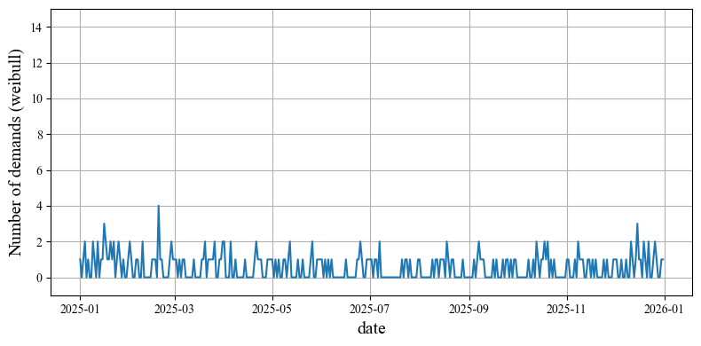
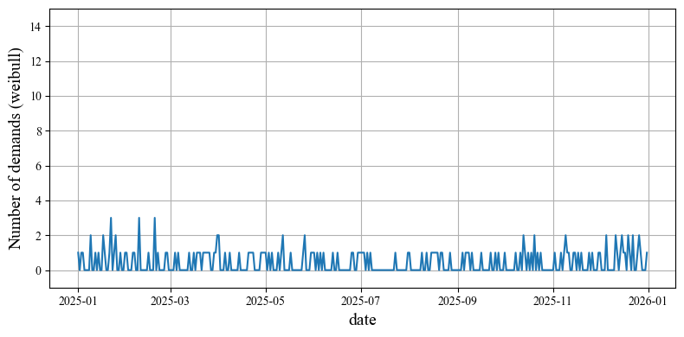
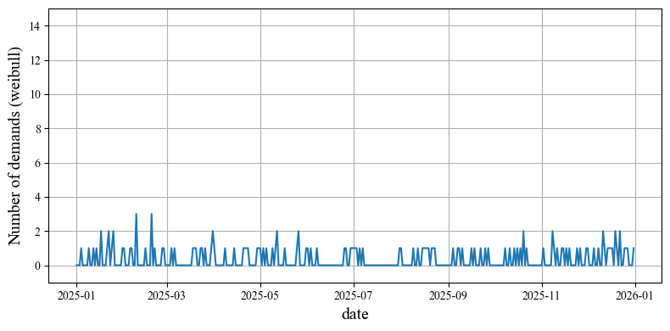
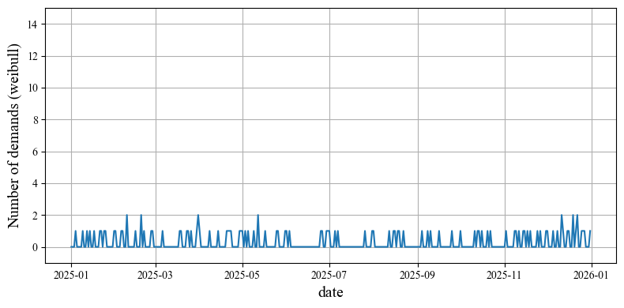
Failure Probability (Weibull, winter part)
m=180
m=270
m=365
ADI=1.61, CoV=1.01, Rate=0.38
ADI=1.97, CoV=1.20, Rate=0.49
ADI=2.17, CoV=1.23, Rate=0.54
m=550
m=730
m=1000
ADI=2.70, CoV=1.44, Rate=0.63
ADI=3.17, CoV=1.59, Rate=0.68
ADI=3.65, CoV=1.69, Rate=0.73
Notes:
By using this coefficients, we can model various types of seasonal patterns, for example, both-season, summer-only, winter-only, and no-season patterns.
Then, I simulated one year of demand
using these seasonality model for the two locations
and several types of failure models.
Specifically, I used
Weibull model, Exponential model, log-logistic model and gompertz model.

Slide 11
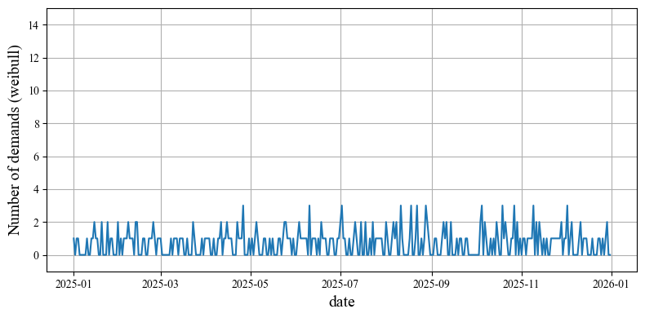
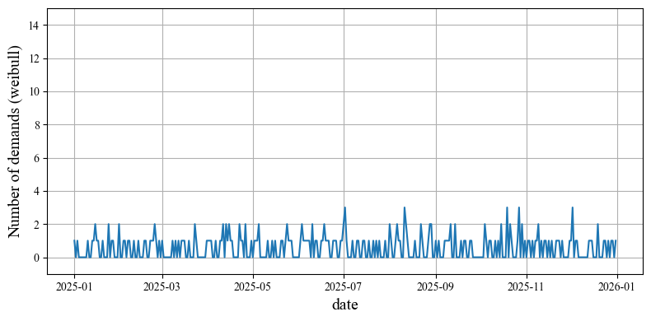
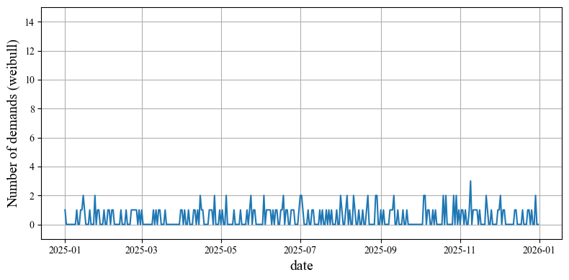
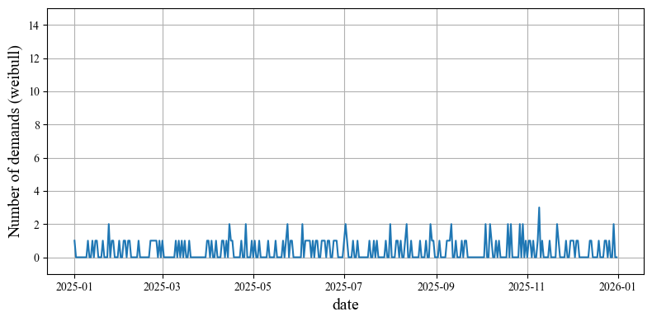
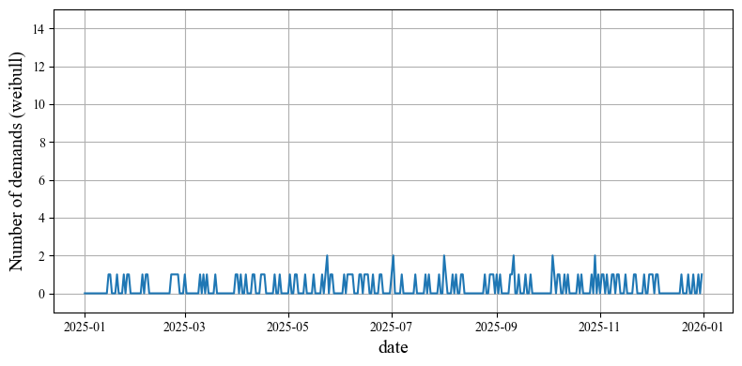
Failure Probability (Weibull, no-season part)
m=180
m=270
m=365
ADI=1.58, CoV=0.97, Rate=0.37
ADI=1.90, CoV=1.15, Rate=0.47
ADI=2.09, CoV=1.19, Rate=0.52
m=550
m=730
m=1000
ADI=2.61, CoV=1.39, Rate=0.62
ADI=2.87, CoV=1.48, Rate=0.65
ADI=3.32, CoV=1.57, Rate=0.70
Notes:
By using this coefficients, we can model various types of seasonal patterns, for example, both-season, summer-only, winter-only, and no-season patterns.
Then, I simulated one year of demand
using these seasonality model for the two locations
and several types of failure models.
Specifically, I used
Weibull model, Exponential model, log-logistic model and gompertz model.

Slide 12
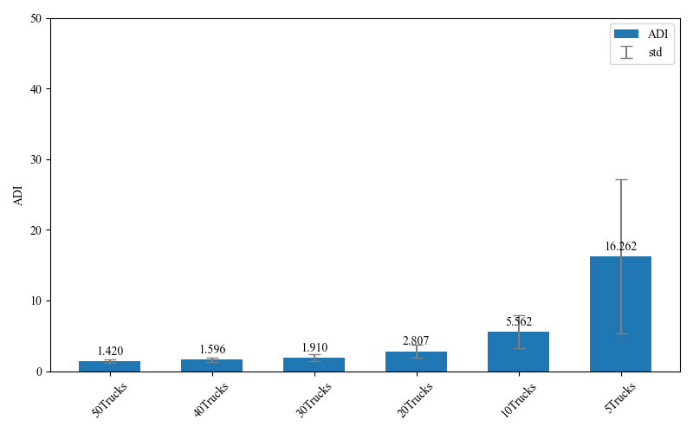
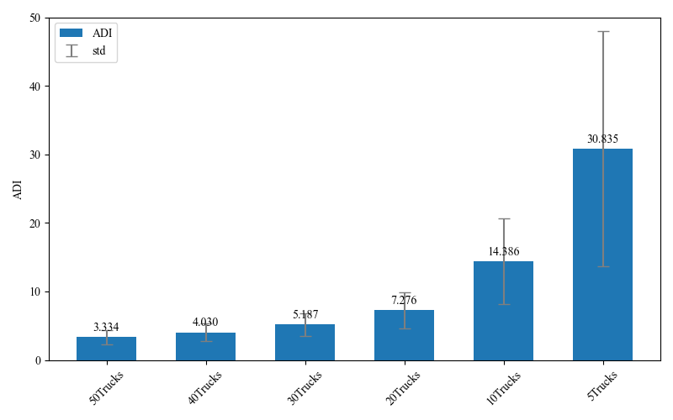
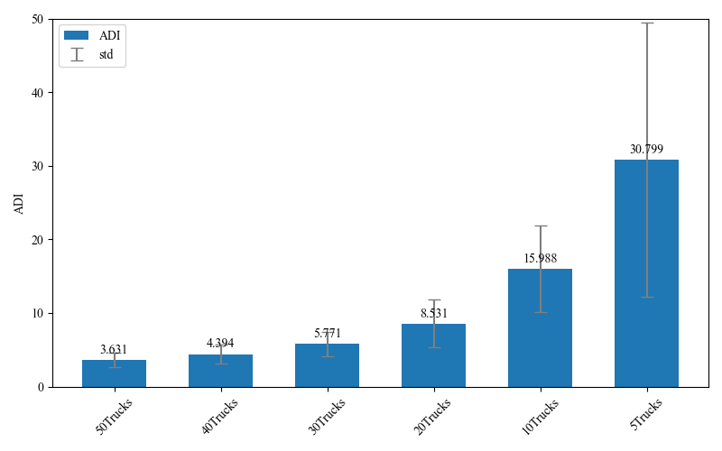
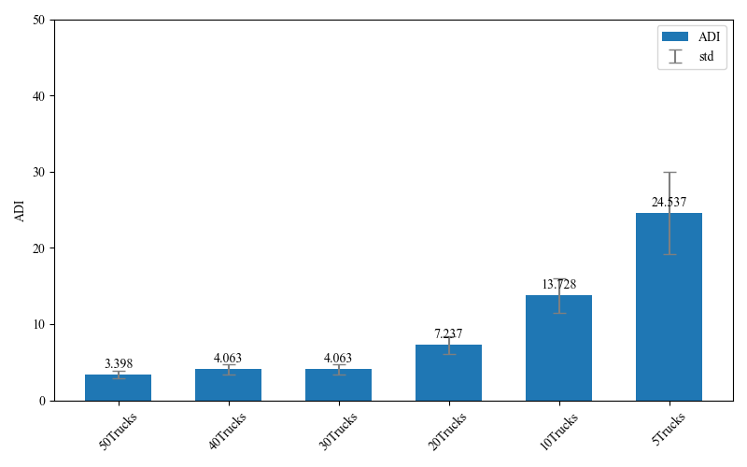
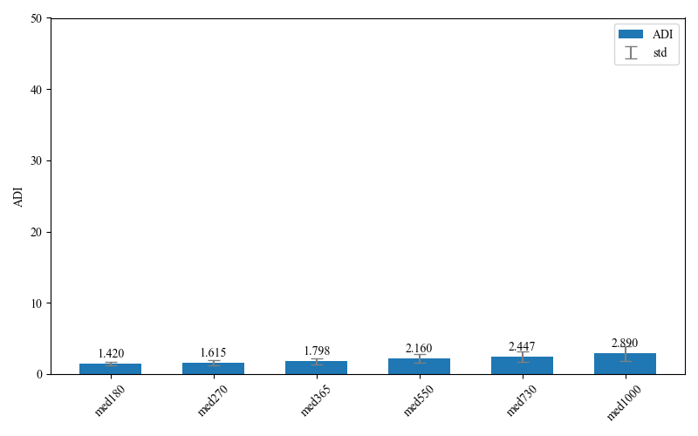
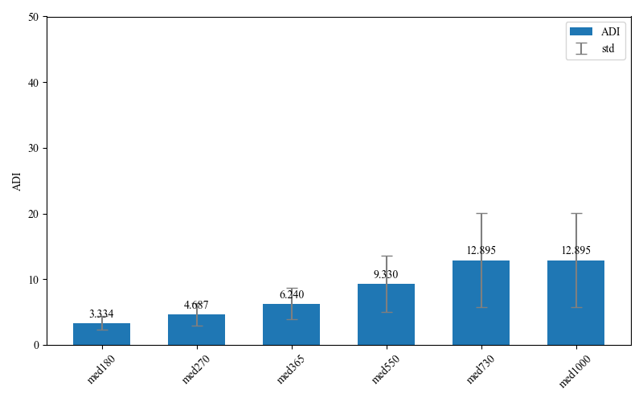
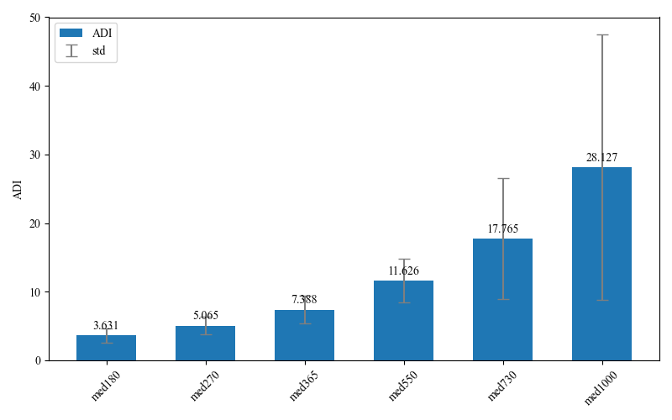

ADI in each failure model
Weibull
Exponential
Log-logistic
Gompertz
Number of trucks
Number of trucks
Number of trucks
Number of trucks
50
40
30
20
10
5
50
40
30
20
10
5
50
40
30
20
10
5
50
40
30
20
10
5
Failure probability
Failure probability
Failure probability
Failure probability
5
5
5
365
550
5
180
270
365
550
730
1000
180
270
365
550
730
1000
180
270
365
550
730
1000
180
270
730
1000
Notes:
By using this coefficients, we can model various types of seasonal patterns, for example, both-season, summer-only, winter-only, and no-season patterns.
Then, I simulated one year of demand
using these seasonality model for the two locations
and several types of failure models.
Specifically, I used
Weibull model, Exponential model, log-logistic model and gompertz model.

Slide 13








Rate in each failure model
Weibull
Exponential
Log-logistic
Gompertz
Number of trucks
Number of trucks
Number of trucks
Number of trucks
50
40
30
20
10
5
50
40
30
20
10
5
50
40
30
20
10
5
50
40
30
20
10
5
Failure probability
Failure probability
Failure probability
Failure probability
5
5
5
365
550
5
180
270
365
550
730
1000
180
270
365
550
730
1000
180
270
365
550
730
1000
180
270
730
1000
Notes:
By using this coefficients, we can model various types of seasonal patterns, for example, both-season, summer-only, winter-only, and no-season patterns.
Then, I simulated one year of demand
using these seasonality model for the two locations
and several types of failure models.
Specifically, I used
Weibull model, Exponential model, log-logistic model and gompertz model.

Slide 14








COV in each failure model
Weibull
Exponential
Log-logistic
Gompertz
Number of trucks
Number of trucks
Number of trucks
Number of trucks
50
40
30
20
10
5
50
40
30
20
10
5
50
40
30
20
10
5
50
40
30
20
10
5
Failure probability
Failure probability
Failure probability
Failure probability
5
5
5
365
550
5
180
270
365
550
730
1000
180
270
365
550
730
1000
180
270
365
550
730
1000
180
270
730
1000
Notes:
By using this coefficients, we can model various types of seasonal patterns, for example, both-season, summer-only, winter-only, and no-season patterns.
Then, I simulated one year of demand
using these seasonality model for the two locations
and several types of failure models.
Specifically, I used
Weibull model, Exponential model, log-logistic model and gompertz model.

Slide 15






Overall Simulation
50
40
30
20
10
5
50
40
30
20
10
5
50
40
30
20
10
5
5
365
550
5
5
180
270
365
550
730
1000
180
270
730
1000
180
270
365
550
730
1000
Notes:
By using this coefficients, we can model various types of seasonal patterns, for example, both-season, summer-only, winter-only, and no-season patterns.
Then, I simulated one year of demand
using these seasonality model for the two locations
and several types of failure models.
Specifically, I used
Weibull model, Exponential model, log-logistic model and gompertz model.

Slide 16
Concept drift
Confirm the seasonality behavior of demand in several failure models.
Integrate demand simulator, forecasting model and cost simulator.
Evaluate forecasting model via the integrated simulator.
Notes:
First, I define the location of each dealer. Next, I introduce a new function that reproduces seasonal demand patterns. Finally, I predict the simulated demand using the XGBoost model.

Slide 17



Sudden drift (Weibull, both-season part)
Notes:
By using this coefficients, we can model various types of seasonal patterns, for example, both-season, summer-only, winter-only, and no-season patterns.
Then, I simulated one year of demand
using these seasonality model for the two locations
and several types of failure models.
Specifically, I used
Weibull model, Exponential model, log-logistic model and gompertz model.

Slide 18


Slow drift (Weibull, both-season part)
Notes:
By using this coefficients, we can model various types of seasonal patterns, for example, both-season, summer-only, winter-only, and no-season patterns.
Then, I simulated one year of demand
using these seasonality model for the two locations
and several types of failure models.
Specifically, I used
Weibull model, Exponential model, log-logistic model and gompertz model.

Slide 19




Differences in each drift (Weibull)
Notes:
By using this coefficients, we can model various types of seasonal patterns, for example, both-season, summer-only, winter-only, and no-season patterns.
Then, I simulated one year of demand
using these seasonality model for the two locations
and several types of failure models.
Specifically, I used
Weibull model, Exponential model, log-logistic model and gompertz model.

Slide 20
Integration of Simulators
Overview
Demand Simulator
Generates synthetic demand data for truck spare parts.
Forecasting Model
Predicts future demand based on the historical demand data.
Cost Simulator
Simulates inventory management based on actual and forecasted demand.
Calculate key performance indicators (KPIs).
Demand
Simulator
Forecasting
model
Cost
Simulator
Demand
data
Forecasted /
actual
demand
Notes:
Next about the integration of simulators.
I integrated demand simulator, forecasting model and cost simulator.
The process flow is like this:
1: Demand simulator
Generates synthetic demand data for truck spare parts.
Provides these data to the forecasting model
2: Forecasting model
Predicts future demand
passes the forecasted and actual (ground-truth) demand data to Cost simulator
3: Cost simulator
Simulates inventory management based on actual and forecasted demand.
Calculates KPIs.
From the next, I will explain the validation of this overall simulator.
Specifically, I will talk about the detailed settings of each component.

Slide 21

1. Demand Simulator
Diagram
Generates 3 years of demand data for each part type held by each dealer, based on failure models.
No. of dealers = 10
No. of trucks = 50
No. of parts = 100
Notes:
First, about the demand simulator.
In the validation,
It generates 3 years of demand data for each part type held by each dealer, based on failure models.
I define 10 dealers.
Attach 50 trucks to each dealer.
Attach 100 types of parts to each part And each part has a failure model,
which is selected from 4 different models and commonly shared among parts of same types.

Slide 22
2. Forecasting Model
Train - Predict
Trained using 2 years of demand data, for all parts across all dealers
Predict demands for the following year of each part in each dealer
Model
XGBoost, Random Forest, SVR (2 types of feature dataset: basic and historical)
ARIMA
Noise data (pseudo forecasting data): adds Gaussian noise (sigma=1.0, 2.5, 5.0) to the actual demand.
Prediction Accuracy Evaluation
MAE: the mean of MAE for all parts across all dealers.
RSME: the mean of RSME for all parts across all dealers.
Notes:
Next about forecasting model.
I trained model using 2 years of demand data, for all parts across all dealers.
And predicted demands for the following year of each part in each dealer
As models, I used
3 machine learning models: XGBoost, Random Forest, SVR
I used 2 types of feature datasets which I mentioned at the previous meeting.
1: Basic feature set (time)
2: Basic plus Historical feature set (statistical data such as the mean of demands in the past days)
I used ARIMA
I used noise data as pseudo forecasting data.
> Its generated by adding gaussian noise to the actual demand.
> I made three types of noise data with distinct standard deviations.
I evaluated prediction accuracy by using MAE and RSME.
I use the mean value of each metric for all parts across all dealers.
Because there are a lot of prediction results and

Slide 23
3. Cost Simulator
Overview
Performs inventory management such as shipment, inventory checking, and replenishment, according to actual (simulated) and forecasted demand over one year.
Calculates KPIs:
Total Cost - the total cost of inventory management for all parts
Service Level - the mean of the immediate service levels for all parts
Policy: standard inventory policy
Parameters (common to all parts)
Lead time: 14 days standard, 2 days urgent, Initial stock: 100 units
Holding costs: rate 15% annually, 0.13 SEK part value
Ordering cost: 100 SEK per regular order (165 SEK per urgent order)
Transporting costs: 2 SEK per kilogram, 0.001 kg per unit
…
Notes:
Finally, about cost simulator.
It performs inventory management such as shipment, inventory checking, and replenishment, according to actual (simulated) and forecasted demand over one year.
Finally, it calculates KPIs:
Total Cost - the total cost of inventory management for all parts
Service Level - the mean of the immediate service levels for all parts
All parameters are set to common value among all parts.
I followed the documents about the cost simulator.
I will proceed to the validation result of this overall simulator.

Slide 24

Demand Prediction Accuracy: MAE
MAE
XGBoost
(basic)
R. Forest
(basic)
SVR
(basic)
XGBoost
(hist.)
R. Forest
(hist.)
SVR
(hist.)
ARIMA
Notes:
This slide shows the prediction results MAE in each forecasting model and noise data.

Slide 25
Demand Prediction Accuracy: MAE
3rd
2nd
1st
MAE
XGBoost
(basic)
R. Forest
(basic)
SVR
(basic)
XGBoost
(hist.)
R. Forest
(hist.)
SVR
(hist.)
ARIMA
Notes:
This slide shows the prediction results MAE in each forecasting model and noise data.

Slide 26

Demand Prediction Accuracy: RMSE
RMSE
XGBoost
(basic)
R. Forest
(basic)
SVR
(basic)
XGBoost
(hist.)
R. Forest
(hist.)
SVR
(hist.)
ARIMA
Notes:
This slide shows the prediction results MAE in each forecasting model and noise data.

Slide 27
Demand Prediction Accuracy: RMSE
1st
2nd
3rd
RMSE
XGBoost
(basic)
R. Forest
(basic)
SVR
(basic)
XGBoost
(hist.)
R. Forest
(hist.)
SVR
(hist.)
ARIMA
Notes:
This slide shows the prediction results MAE in each forecasting model and noise data.

Slide 28

Demand Prediction Accuracy: R2
R2
XGBoost
(basic)
R. Forest
(basic)
SVR
(basic)
XGBoost
(hist.)
R. Forest
(hist.)
SVR
(hist.)
ARIMA
Notes:
This slide shows the prediction results MAE in each forecasting model and noise data.

Slide 29

Demand Prediction Accuracy: RMSE
IAE
XGBoost
(basic)
R. Forest
(basic)
SVR
(basic)
XGBoost
(hist.)
R. Forest
(hist.)
SVR
(hist.)
ARIMA
Notes:
This slide shows the prediction results MAE in each forecasting model and noise data.

Slide 30
Demand Prediction Accuracy: RMSE
2nd
1st
2nd
IAE
XGBoost
(basic)
R. Forest
(basic)
SVR
(basic)
XGBoost
(hist.)
R. Forest
(hist.)
SVR
(hist.)
ARIMA
Notes:
This slide shows the prediction results MAE in each forecasting model and noise data.

Slide 31




Demand Prediction Accuracy: MAE
MAE
1st
3rd
2nd
XGBoost
(basic)
R. Forest
(basic)
SVR
(basic)
XGBoost
(hist.)
R. Forest
(hist.)
SVR
(hist.)
ARIMA
noise
($σ=1.0$)
noise
($σ=2.5$)
noise
($σ=5.0$)
Notes:
As you can see,
XGBoost with basic feature achieved the best accuracy.
Following that, SVR and XGBoost with historical feature show better accuracy.
About noise data,
The accuracy get worse as the standard deviation increase.
Especially, MAE increases by a corresponding multiple as the noise level

Slide 32

Demand Prediction Accuracy : RMSE
RMSE
XGBoost
(basic)
R. Forest
(basic)
SVR
(basic)
XGBoost
(hist.)
R. Forest
(hist.)
SVR
(hist.)
ARIMA
noise
($σ=1.0$)
noise
($σ=2.5$)
noise
($σ=5.0$)
Notes:
This slide shows the prediction results RSME in each forecasting model and noise data.

Slide 33
Demand Prediction Accuracy : RMSE
RMSE
2nd
3rd
1st
XGBoost
(basic)
R. Forest
(basic)
SVR
(basic)
XGBoost
(hist.)
R. Forest
(hist.)
SVR
(hist.)
ARIMA
noise
($σ=1.0$)
noise
($σ=2.5$)
noise
($σ=5.0$)
Notes:
As you can see,
XGBoost with basic feature achieved the best accuracy.
Following that, SVR and XGBoost with historical feature show better accuracy.
About noise data,
The accuracy get worse as the standard deviation increase.
Especially, MAE increases by a corresponding multiple as the noise level.

Slide 34

KPI: Total Cost
Total cost
XGBoost
(basic)
R. Forest
(basic)
SVR
(basic)
XGBoost
(hist.)
R. Forest
(hist.)
SVR
(hist.)
ARIMA
noise
($σ=1.0$)
noise
($σ=2.5$)
noise
($σ=5.0$)
Notes:
This slide shows the KPIs calculated by cost simulator
using forecated demand made by each and noise data.

Slide 35

KPI: Total Cost
3rd
Total cost
1st
2nd
XGBoost
(basic)
R. Forest
(basic)
SVR
(basic)
XGBoost
(hist.)
R. Forest
(hist.)
SVR
(hist.)
ARIMA
noise
($σ=1.0$)
noise
($σ=2.5$)
noise
($σ=5.0$)
Notes:
As you can see, in terms of Total cost,
the model with the best prediction accuracy — XGBoost (basic features) — is placed third. Instead, XGBoost and SVR with historical feature show are placed first and second.
About noise data,
The accuracy get larger as the standard deviation increase.
But, it didn’t significantly increase like MAE.

Slide 36

KPI: Service Level
Service level
XGBoost
(basic)
R. Forest
(basic)
SVR
(basic)
XGBoost
(hist.)
R. Forest
(hist.)
SVR
(hist.)
ARIMA
noise
($σ=1.0$)
noise
($σ=2.5$)
noise
($σ=5.0$)
Notes:
This slide shows the service level calculated by cost simulator
using forecated demand made by each and noise data.

Slide 37
KPI: Service Level
3rd
1st
2nd
Service level
XGBoost
(basic)
R. Forest
(basic)
SVR
(basic)
XGBoost
(hist.)
R. Forest
(hist.)
SVR
(hist.)
ARIMA
noise
($σ=1.0$)
noise
($σ=2.5$)
noise
($σ=5.0$)
Notes:
As you can see, the ranking is same as the total cost.
About noise data,
The service level didn’t change if the standard deviation increase.

Slide 38

Result: Correlation Coefficient
 | XGBoost (basic) | R. Forest (basic) | SVR (basic) | XGBoost (hist.) | R. Forest (hist.) | SVR (hist.) | ARIMA | Max | Min
MAE vs. Total cost | 0.33 | 0.51 | 0.07 | 0.38 | 0.49 | 0.12 | 0.09 | 0.51 | 0.07
RMSE vs. Total cost | 0.34 | 0.58 | 0.15 | 0.38 | 0.49 | 0.12 | 0.25 | 0.58 | 0.12
MAE vs. Service level | 0.04 | -0.26 | 0.21 | -0.06 | -0.02 | 0.35 | 0.08 | 0.35 | -0.26
RMSE vs. Service level | 0.04 | -0.33 | 0.12 | -0.06 | -0.03 | 0.34 | -0.05 | 0.34 | -0.33
noise ($σ=1.0$) | noise ($σ=2.5$) | noise ($σ=5.0$)
0.69 | 0.37 | 0.60
0.66 | 0.27 | 0.57
-0.37 | -0.32 | -0.34
-0.37 | -0.30 | -0.33
Notes:
This slide shows the correlation coefficient between prediction accuracy metrics and kpis in each model.
In all comparisons, no strong relationship is observed．

Slide 39


Total Cost vs. MAE, RMSE (XGBoost)
Total cost
Total cost
MAE
RMSE
Notes:
This slide shows the scatter plot of Total Cost versus MAE and RMSE for the XGBoost model.
The red line shows the linear regression result between 2 metrics.
There is no linear relationships.

Slide 40


Service Level vs. MAE, RMSE (XGBoost)
Service Level
Service Level
MAE
RMSE

Slide 41
The Paper Concept for IDA2026
Overview – Practical Forecast Model Evaluation in Inventory Management
Research Question:
Forecasting model selection, or evaluation, generally relies on prediction accuracy metrics such as MAE and RMSE. However, these metrics do not necessarily reflect the operational impact in inventory management.
There is no established relationship between prediction accuracy metrics and operational KPIs.
What is the adequate metric for evaluating or selecting the models in a real operational context?
Objective:
To reveal the relationship, or gap, between conventional metrics and operational KPIs.
To demonstrate that KPIs can serve as practical evaluation metrics for models.
Framework
Demand Simulator - generate synthetic demand data.
ML model - predict future demand.
Cost Simulator -

